Slide 1
The Growth
of the
American
Labor Movement

Slide 2
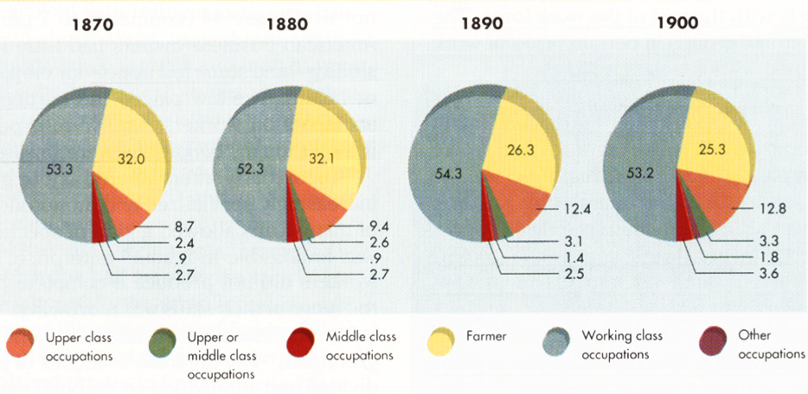
Labor Force Distribution 1870-1900

Slide 3
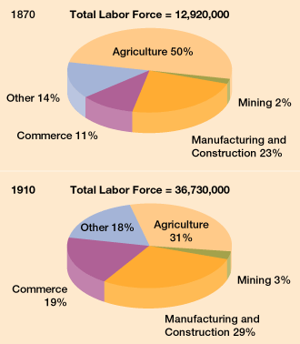
The Changing American Labor Force

Slide 4
Picture: Workers vs Owner
WORKER VS EMPLOYER
“The old familiar relations between employer and employee were passing. A few generations before, the boss had known every man in his shop. He called his men by their first names, asked about the family and swapped jokes and stories with them. Today, you have large factories, the personal touch is gone!”
Theodore Roosevelt
“IMPERSONALIZATION”
Notes:
Arduous, dangerous work conditions
Diminishing control over their own work
Growing sense of powerlessness

Slide 5
INDUSTRALIZATION
Poor working conditions
Unfriendliness/impersonalization
Immigrants taking jobs
Decrease work day
Machines replacing workers
Child labor
Job security
Picture: Workers vs Owner

Slide 6
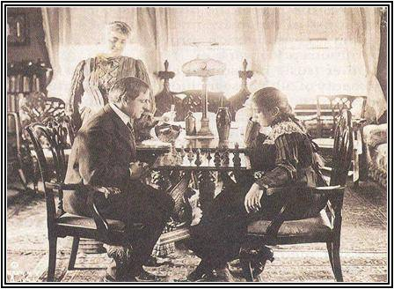
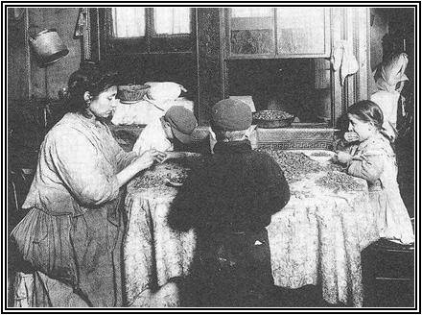
TWO DIFFERENT WORLDS
The wealthy would manifest itself in an elite class of Americans who lived extravagant lifestyles. Many common people resented their snobbish attitudes and wealth. In some respects, there was a caste system in the U.S.

Slide 7
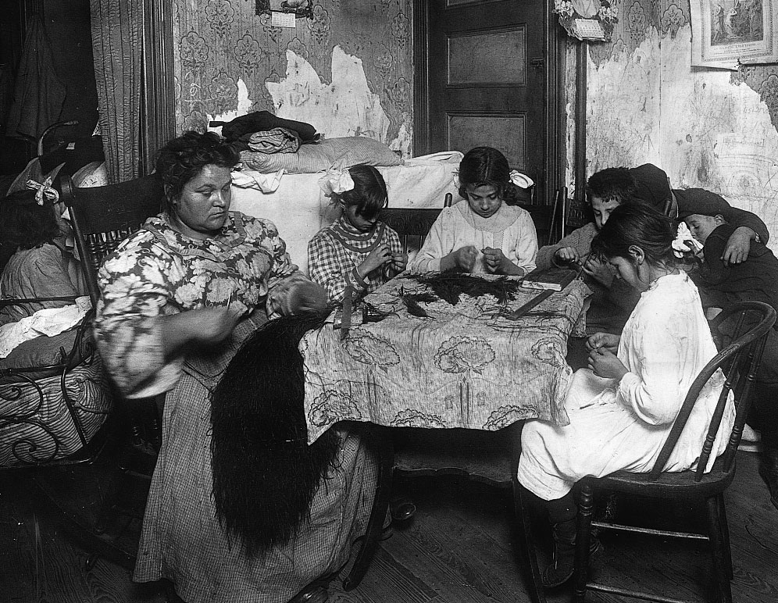
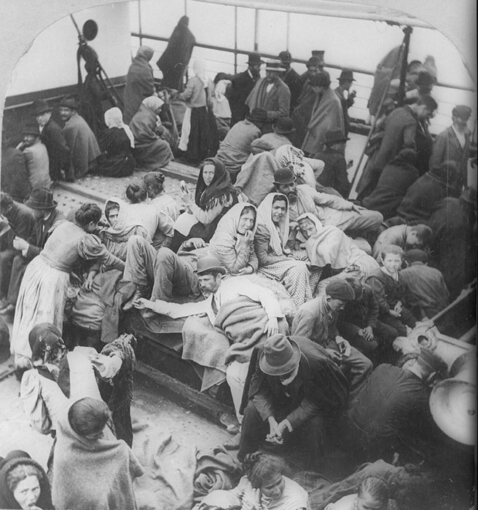
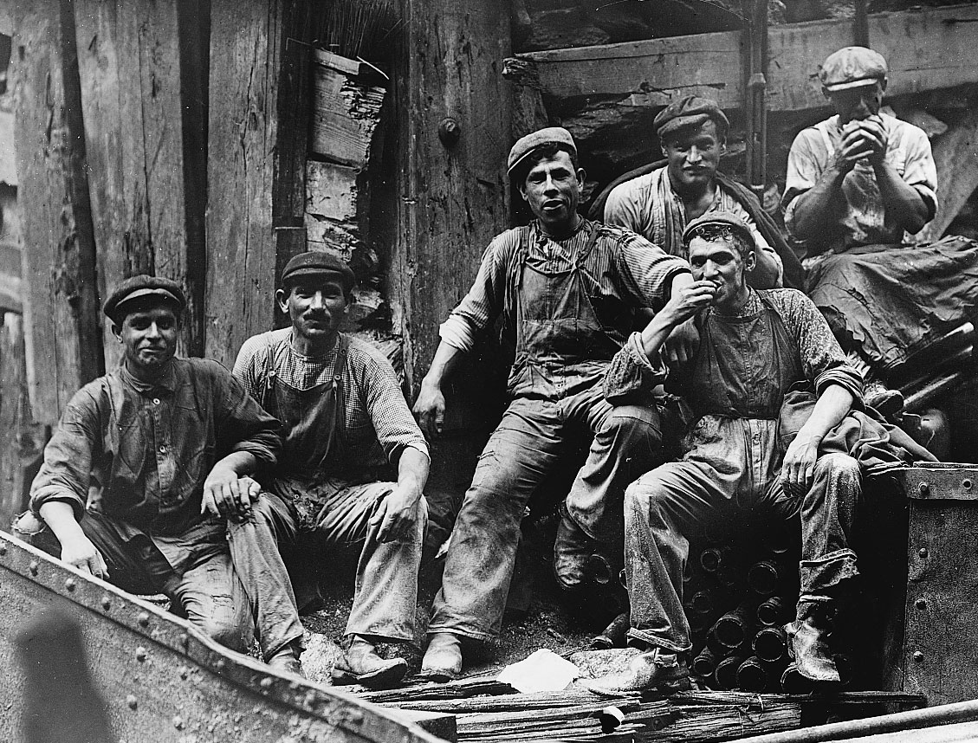
Immigration
Notes:
Demand for factory labor grew
Met by
Farmers moving into cities
Immigrants. 25 million from 1865-1915
1870-80s: immigrants from traditional sources (England, Ireland and Northern Europe)
1880s-onwards: from Southern and Eastern Europe (Italian, Greek, Russians, Poles, Slavs); Mexican and Chinese in West
Immigrants came here b/c faced poverty and oppression and new opportunities
How did they get here?
Sometimes lured by false advertising
Foreign born labor brokers who recruited work gangs of their fellow nationals

Slide 8
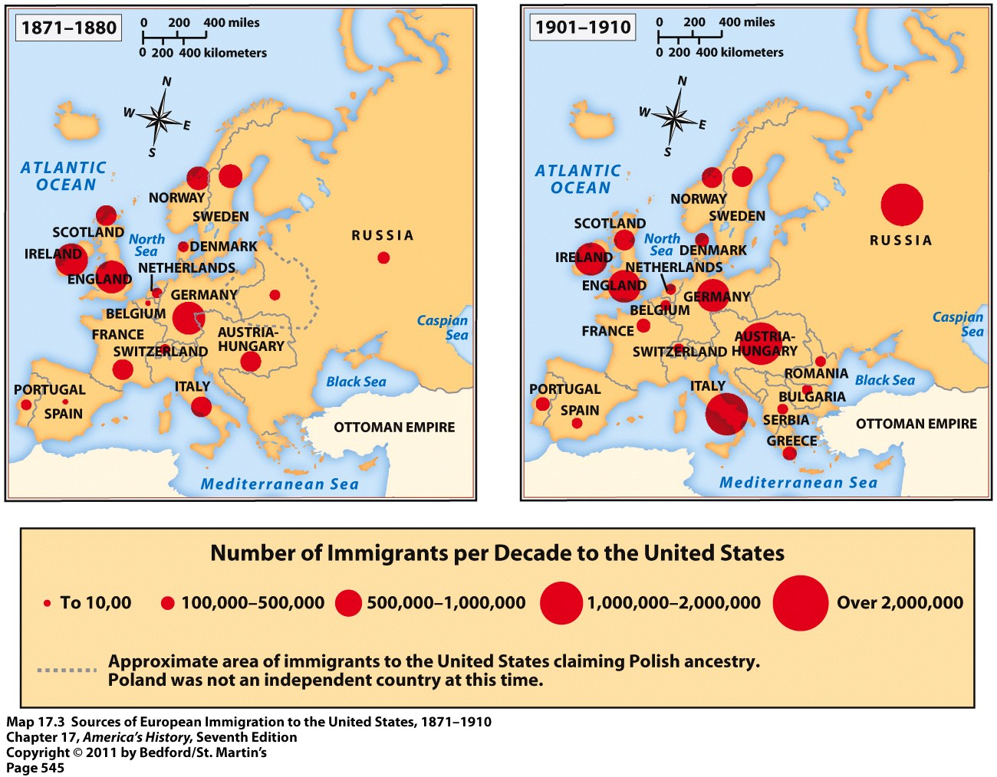
Notes:
Heightened Ethnic Tensions
Low paid Poles, Greeks and French Canadians displaced British and Irish workers in New England
Italians, Slavs and Poles displaced northern immigrant Europeans in the East
Chinese and Mex displaced Anglo and African American workers in the West and Texas

Slide 9
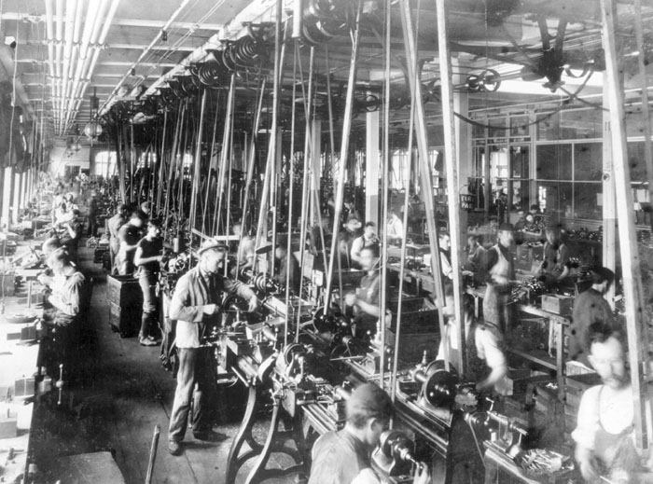
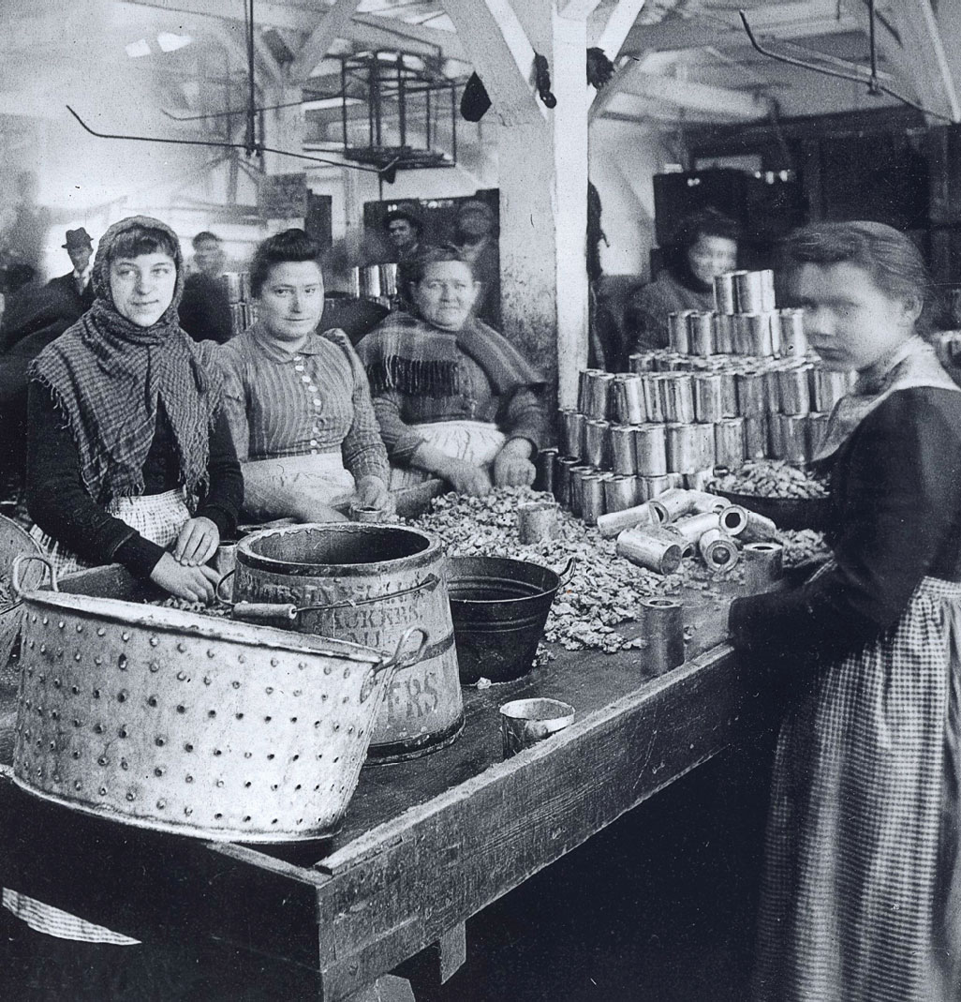
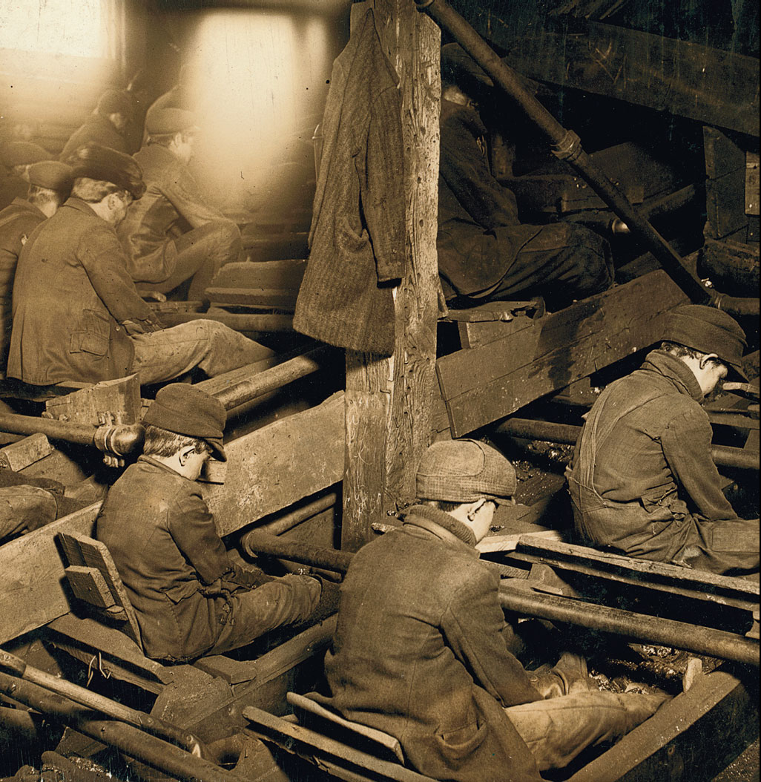
Working Conditions
Notes:
1900: average worker salary was $400-500; below the $600 figure considered the minimum for a reasonable level of comfort
Even those who had jobs could find their wages cut substantial
Other hardships faced:
Work was becoming routine and monotonous and required little skill
New system was impersonal and demeaning
10-12 our days, 6 days a week
unsafe and unhealthy work conditions
loss of control over conditions of labor (salary, time)
the workplace was in control of the managers; workers had no authority or control that might disrupt production
Women and Children at Work
Decreasing need for skilled work led employers to higher women (kept salaries low)
By 1900, women made up 17% of the industrial workforce (4X the number in 1870
20% of all women were wage earners
Some were single and took jobs to support themselves, parents or siblings
Many were married women; in this economy, working class families needed 2 incomes
Men and women didn't like women working; it was inappropriate
Women workers were white and 75% under 25
Vast majority were immigrants or daughters of immigrants
Textile industry was #1 employer
Average annual salary was $314 compared to $597 for man

Slide 10
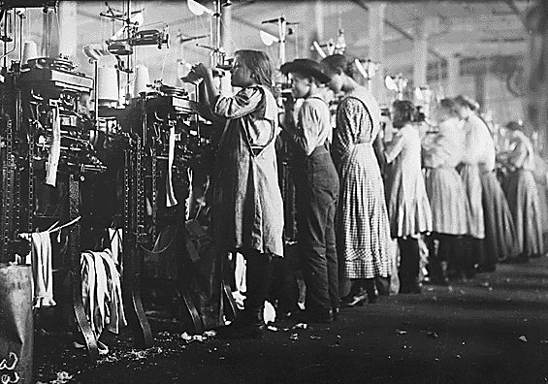
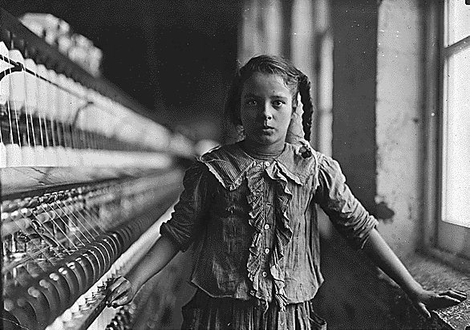
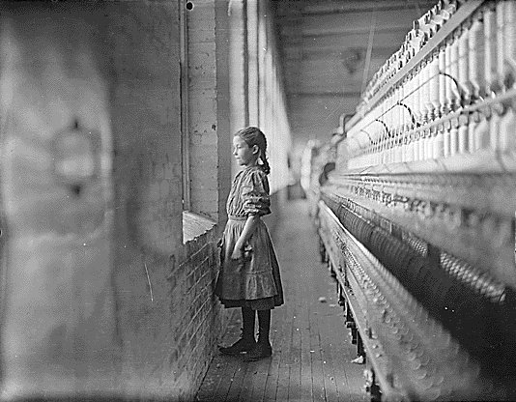
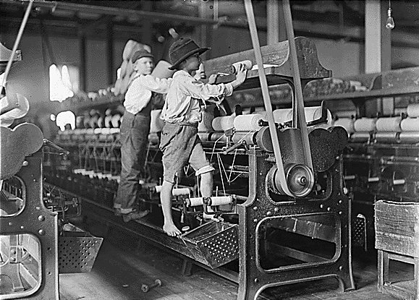
Child Labor
Notes:
1.7 million children under 16 worked in factories and fields in 1900 (2X more than in 1870)
10% of all girls and 20% of all boys 10-15 had jobs
Families so desperate for extra income that they made kids work
Some children worked instead of mother working
Child labor laws passed but were not enforced
Worked 10-12 hours a day
American accident rate higher than in any other part of the world (12 men died a week on RRs in 1907)

Slide 11
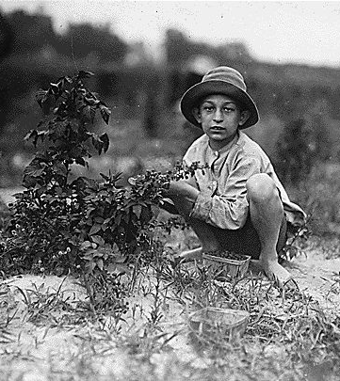
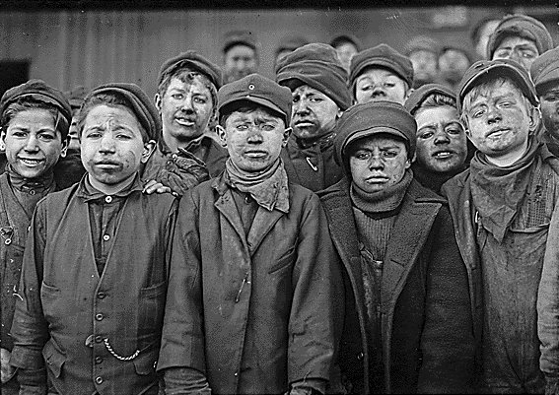
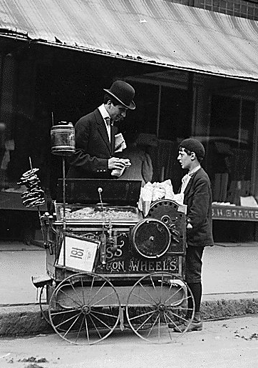
Child Labor

Slide 12
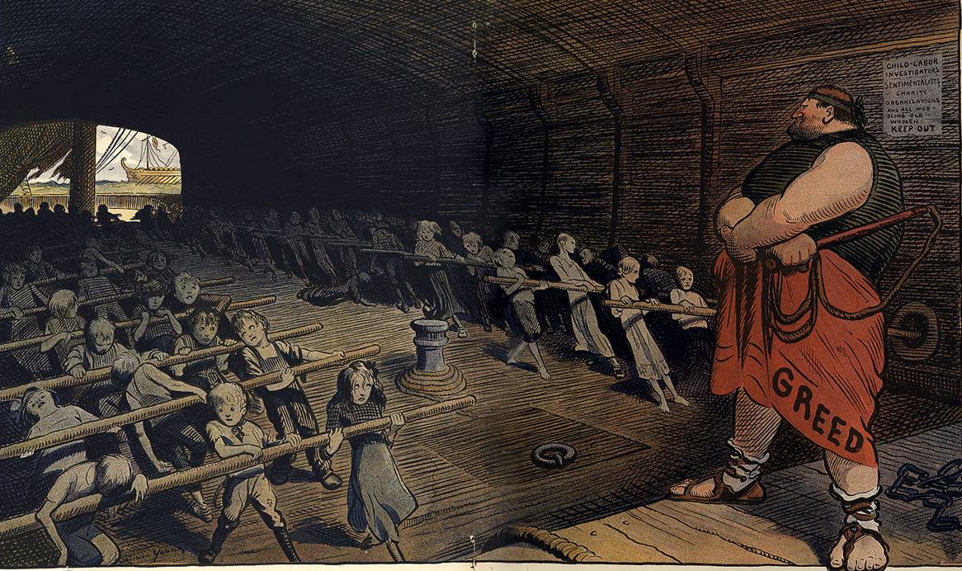
“Galley Labor”

Slide 13
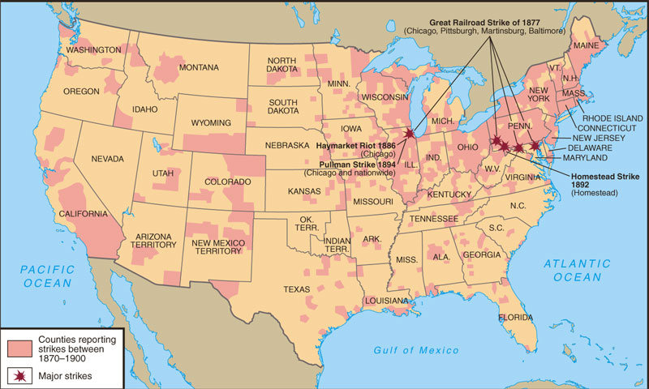
Labor Unrest: 1870-1900
Notes:
Create large combinations to combat some of the abuses: unionize
1866: National Labor Union
first attempt at a federated union
Variety of reform groups with little direct relationship with labor
Excluded women
Disappeared after Panic if 1873

Slide 14
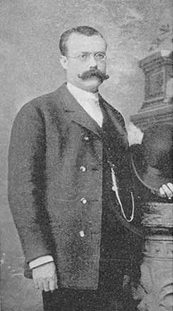
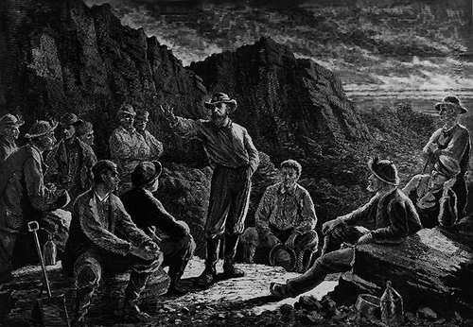
The Molly Maguires (1875)
James McParland
Notes:
1870s difficult time for unions because of widespread unemployment but also because of middle-class hostility to the labor movement which saw union members as anarchists
“Molly Maguires”: anthracite coal region miners in PA who were Irish and used intimidation, violence and sometimes murder to put pressure on mgmt. But lots of violence can be blamed on mgmt. spies that subverted the Maguires

Slide 15
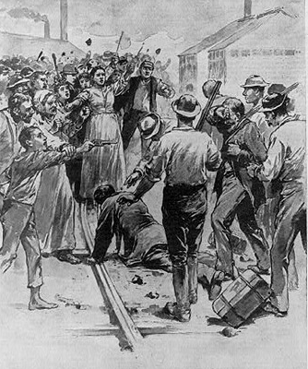
The Corporate “Bully-Boys”: Pinkerton Agents

Slide 16
Management vs. Labor
“Tools” of Management
“Tools” of Labor
“scabs”
P. R. campaign
Pinkertons
lockout
blacklisting
yellow-dog contracts
court injunctions
open shop
boycotts
sympathy demonstrations
informational picketing
closed shops
organized strikes
“wildcat” strikes

Slide 17
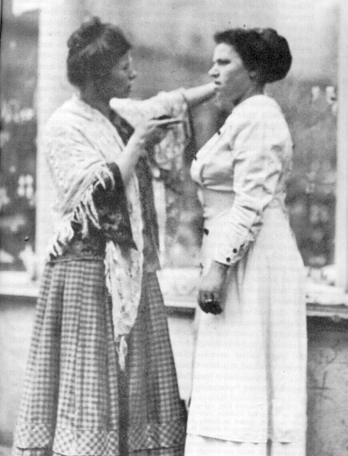
A Striker Confronts a SCAB!

Slide 18
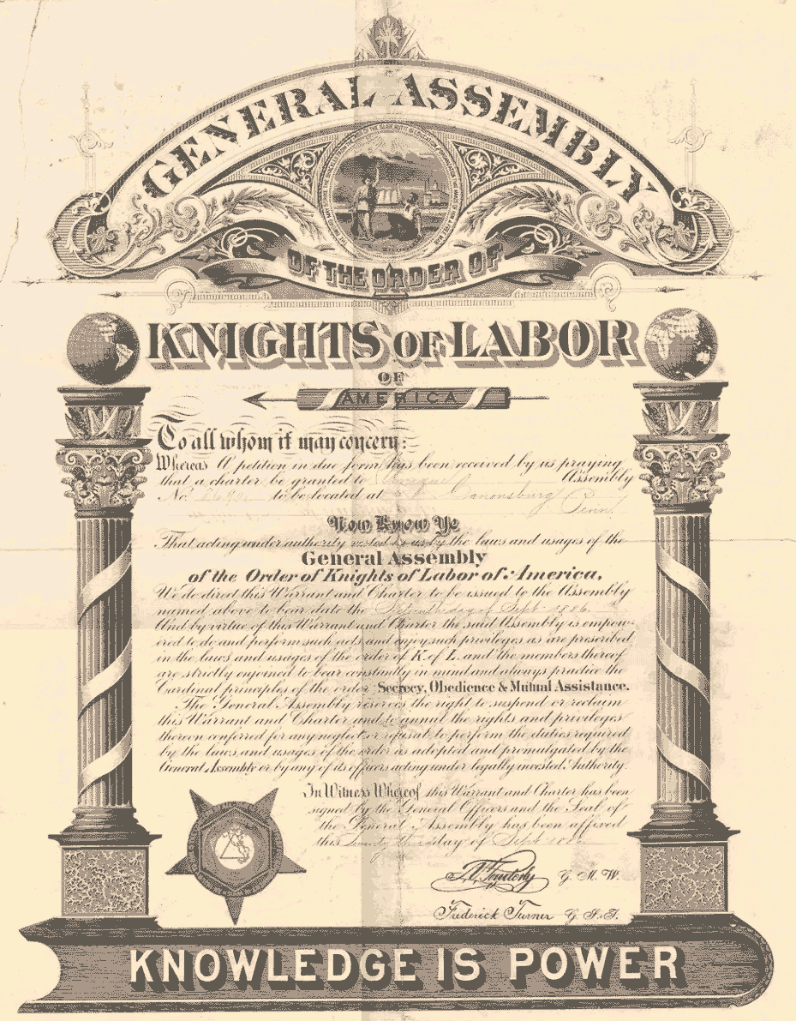
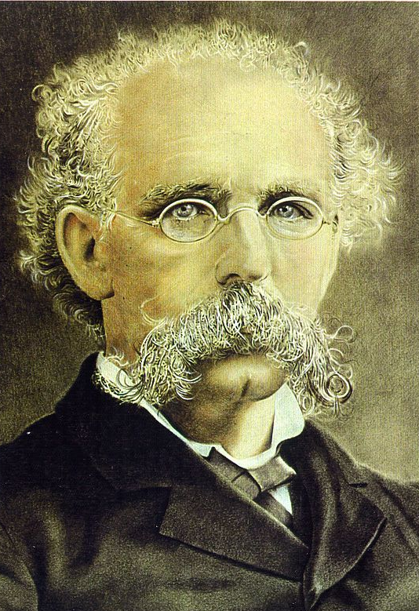
Knights of Labor
Terence V. Powderly
An injury to one is the concern of all!
Notes:
First genuine labor organization
1869 by Uriah Stephens
Included all workers and most business and professional people except bankers, liquor dealers and gamblers
Welcomed women event domestic servants and women who worked in their homes
Loosely organized local assemblies had loose ties to a national “general assembly”

Slide 19
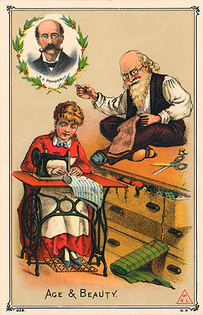
Knights of Labor
Knights of Labor trade card
Notes:
Beliefs
8 hour work day
end to child labor
replace wage system with cooperative system in which workers would control large part of economy
A first a secret org then public in 1870s under leadership of Terence Powderly
Leadership could not always control local unions
Hurt by Haymarket Square Riot which led to its demise

Slide 20
Goals of the Knights of Labor
Eight-hour workday.
Workers’ cooperatives.
Worker-owned factories.
Abolition of child and prison labor.
Increased circulation of greenbacks.
Equal pay for men and women.
Safety codes in the workplace.
Prohibition of contract foreign labor.
Abolition of the National Bank.

Slide 21
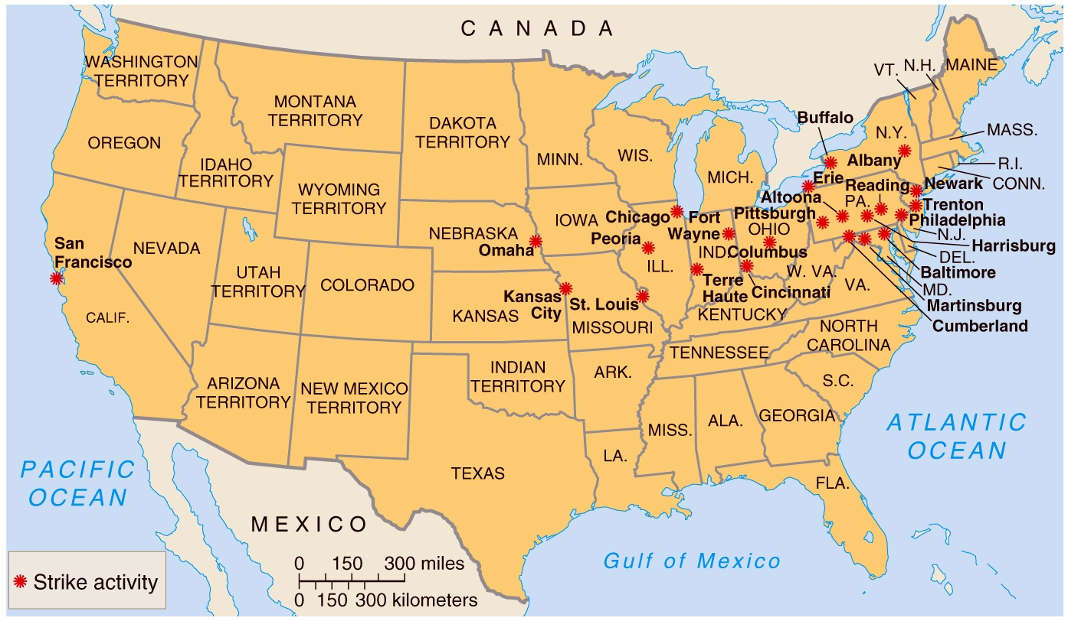
The Great Railroad Strike of 1877
Notes:
First major national labor conflict
1877: eastern RRs announced a 10% cut in wages
Strikers disrupted service from Baltimore to St. Louis
Militias in different states were used to subdue the strike
After 100 ppl died the strike was over after several weeks
What did strike illustrate?
Disputes between workers and employers couldn't be localized
Depth of resentment of American worker toward their employers and the got that allied with them
Indicated the frailty of the labor movement (weakened RR unions and labor organizations in other industries as well)

Slide 22
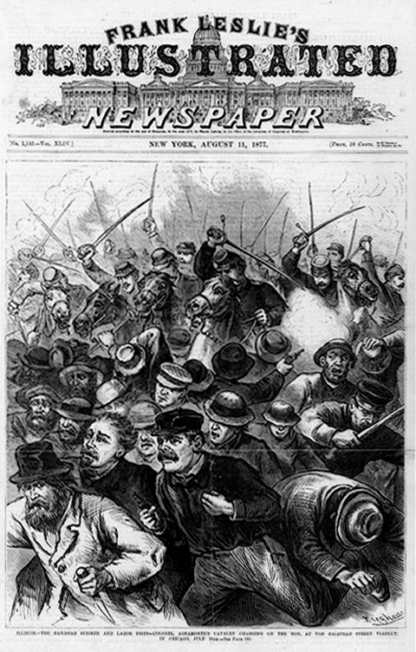
The Great Railroad Strike of 1877

Slide 23
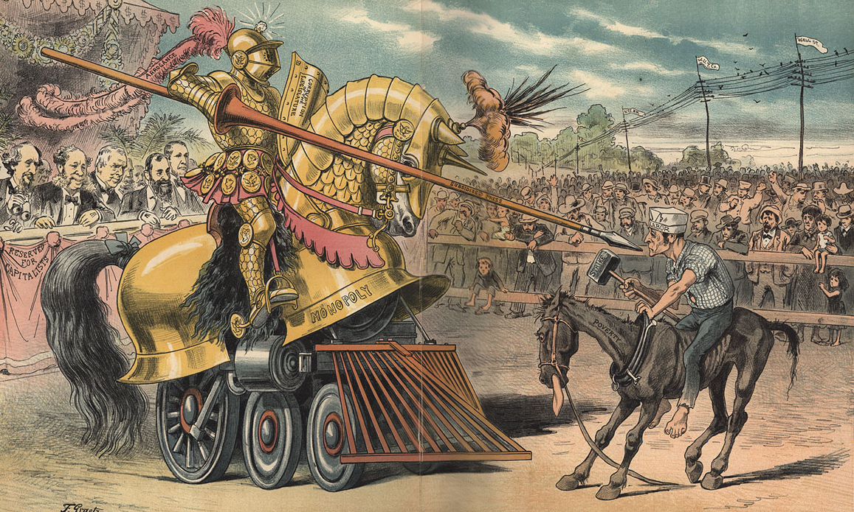
The Tournament of Today: A Set-to Between Labor and Monopoly

Slide 24
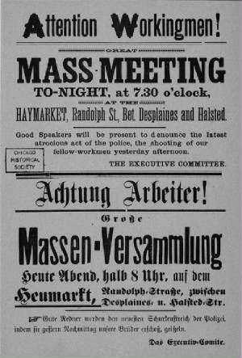
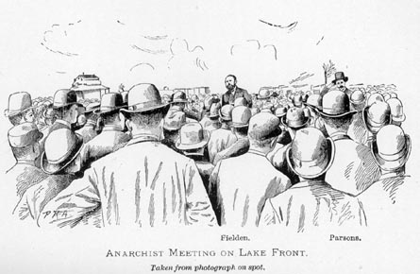
Anarchists Meet on the Lake Front in 1886

Slide 25
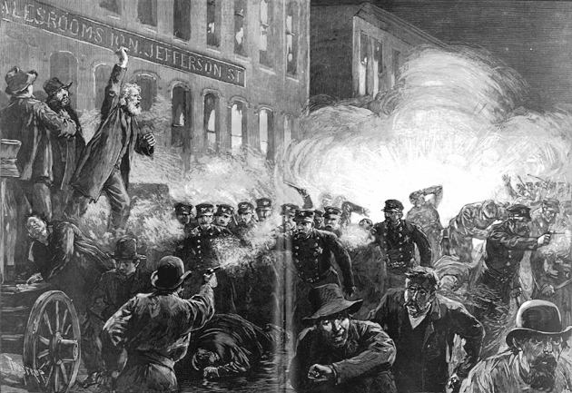
Haymarket Riot (1886)
McCormick Harvesting Machine Co.
Notes:
Strike was already underway at McCormick Harvester Company
City police had been harassing strikers
Labor and radical leaders called for meeting at the square
Police order crowd to disperse; someone throws a bomb and kills seven police officers, injures 67 other ppl
Police day before had killed 4 strikers fired into the crowd and killed 4 more people
Conservative, property-conscious Americans demanded retribution

Slide 26
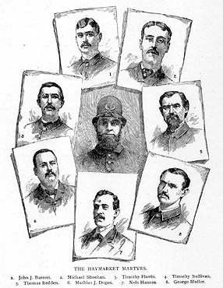
Haymarket Martyrs
Notes:
4 were executed
Later gov of Illinois Peter Altgeld, pardoned the remaining anarchists
Again to most of the middle class, Haymarket bombing was a symbol of social chaos. Anarchism became code word for terrorist even though most anarchists were peaceful visionaries
Anarchists became the biggest obstacle to the growth of labor unions
KoL never recovered from this

Slide 27
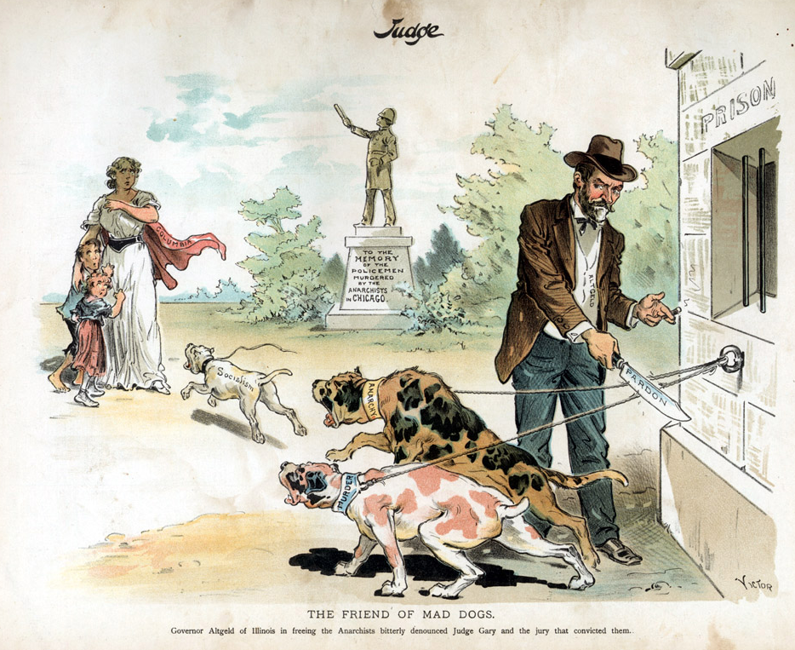
Governor John Peter Altgeld

Slide 28
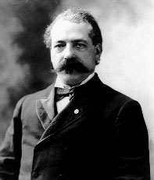
The American Federation of Labor: 1886
Samuel Gompers
Notes:
1881: American Federation of Labor
rejected KoL idea of one union for everybody
association of autonomous craft unions and mainly represented skilled workers
led by Samuel Gompers
opposed to women in workforce because it hurt the family but supported equal pay for women because by raising their pay, made them less attractive to employers so they would be forced out of workplace

Slide 29
How the AF of L Would Help the Workers
Catered to the skilled worker.
Represented workers in matters of national legislation.
Maintained a national strike fund.
Evangelized the cause of unionism.
Prevented disputes among the many craft unions.
Mediated disputes between management and labor.
Pushed for closed shops.
Notes:
Secure greater share of capitalism’s material rewards
Against a workingmen's party
Opposed to govt help in protecting labor or making better working conditions because then govt could just take away whenever they want
Better wages and working conditions
Collective bargaining
8 hour day
strikes
Called for a national strike if workers did not achieve a national 8 hour day by May 1, 1886.
Haymarket Riot

Slide 30
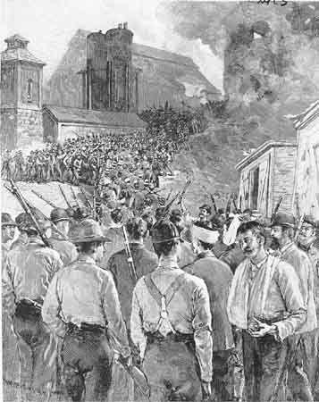
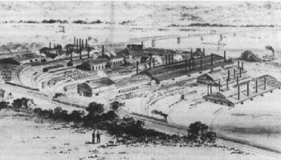
Homestead Steel Strike (1892)
Homestead Steel Works
The Amalgamated Association of Iron & Steel Workers
Notes:
Amalgamated Association of Iron and Steel Workers (affiliated with AFL) was most powerful trade union in country
Managers hated the power the union had because skilled steel workers in high demand
By mid- 1880s, steel industry introduced changes to process that made steelmaking more streamlined and less dependent on skilled labor
1890: Carnegie and his close associate Henry Clay Frick want to get rid of the union

Slide 31
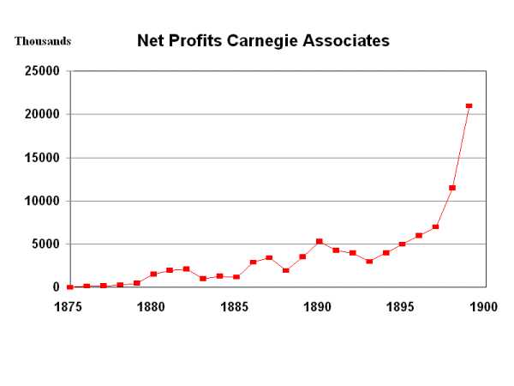
Big Corporate Profits!
Notes:
1892: Company stopped negotiating with the Union
Announced a wage cut
Union called for a strike
Frick hired Pinkerton agency to break the strike and allow the plant to reopen with new workers
Strikers were waiting for the Pinkertons; oil in water set it ablaze, guns and dynamite; Pinkertons surrender
Frick convinces governor to call National Guard of 8K troops to protect strikebreakers as they worked

Slide 32
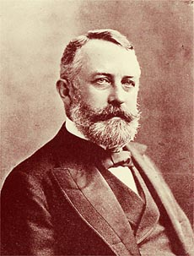
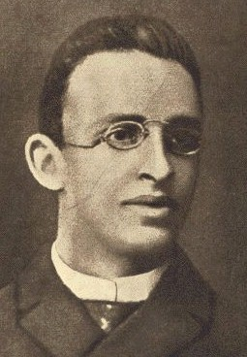
Attempted Assassination!
Henry Clay Frick
Alexander Berkman
Notes:
Public opinion turned when radical attempted to murder Frick
Slowly workers began going back to work
After 4 months the union surrendered
By 1900, all steel plants had separated from the Amalgamated union
Decline of the union was symbol of erosion of union strength as factory labor became increasingly unskilled

Slide 33
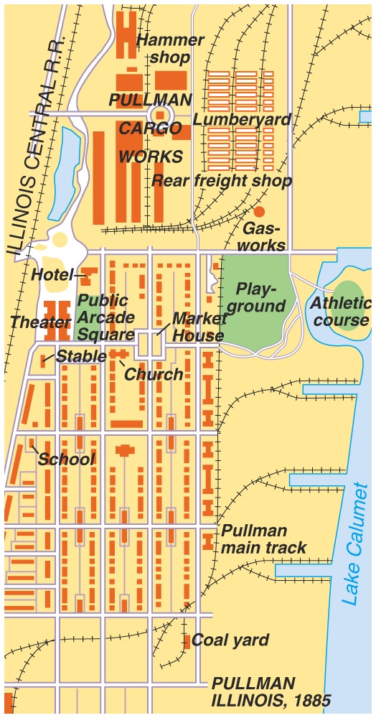
A “Company Town”:
Pullman, IL

Slide 34
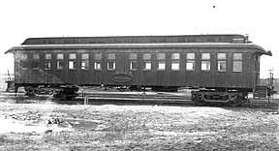
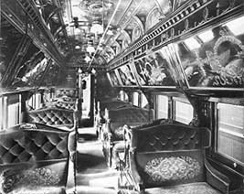
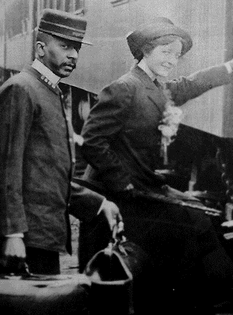
Pullman Cars
A Pullman porter
Notes:
1894
Pullman Company made sleeping and parlor cars
600 acre company town
winter of 1893-4; Pullman slashed wages by 25% because of the Panic of 1893; but Pullman did not cut rents which were already 20-25% higher than the rents in the surrounding areas
Workers went on strike

Slide 35
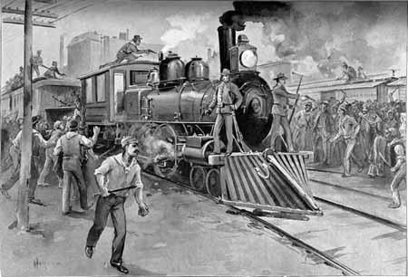
The Pullman Strike of 1894

Slide 36
Eugene Debs: American Railway Union
Notes:
Persuaded the American Railway Union led by Eugene Debs to join in the strike
They did and asked their members not to handle Pullman cars and equipment
Thousands of workers in 27 states went on strike; transportation from Chicago to Pacific was at a standstill
Gov of IL Altgeld refused to use state militia to help out Pullman

Slide 37
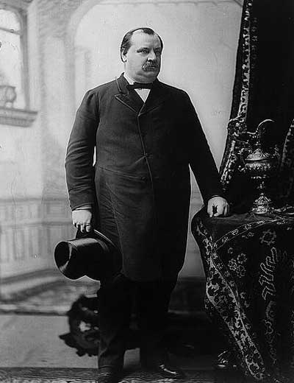
President Grover Cleveland
If it takes the entire army and navy to deliver a postal card in Chicago, that card will be delivered!
Notes:
Convinced Pres. Cleveland and Attorney General Richard Olney (former railroad lawyer who hated unions) to dispatch 2K troop to the Chicago area

Slide 38
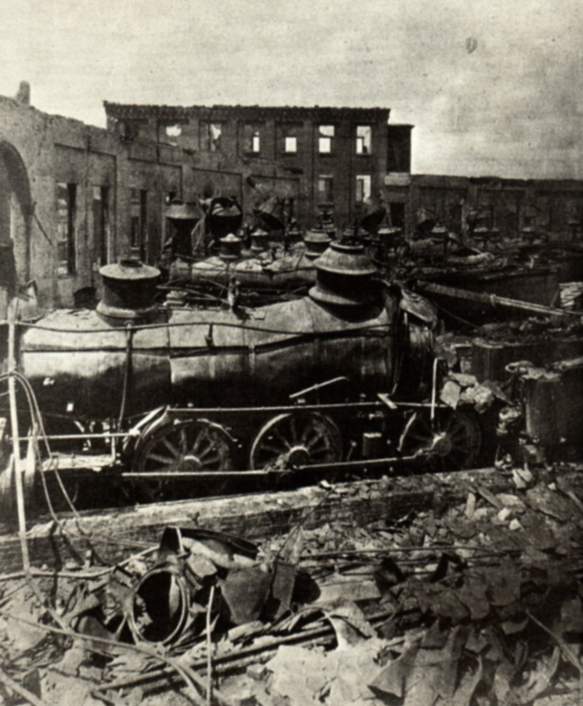
The Pullman Strike of 1894
Government by injunction!
Notes:
Federal court issued injunction to end strike; but strike continued
Debs and other leaders were arrested
With federal troops protecting the hiring of new workers, leaders in jail, the strike collapsed

Slide 39
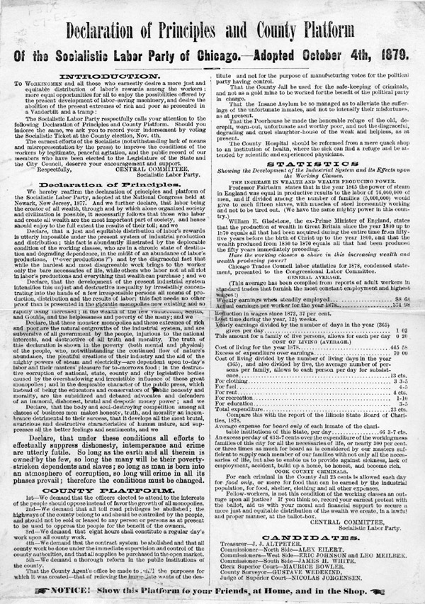
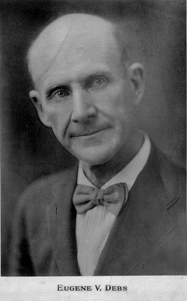
The Socialists
Eugene V. Debs

Slide 40
International Workers of the World (“Wobblies”)

Slide 41
“Big Bill” Haywood of the IWW
Violence was justified to overthrow capitalism.

Slide 42
I W W & the Internationale

Slide 43
The Hand That Will Rule the World→ One Big Union

Slide 44
Mother Jones: “The Miner’s Angel”
Mary Harris.
Organizer for the United Mine Workers.
Founded the Social Democratic Party in 1898.
One of the founding members of the I. W. W. in 1905.

Slide 45
Lawrence, MA Strike: 1912

Slide 46
The “Bread & Roses” Strike
DEMANDS:
15¢/hr. wage increase.
Double pay for overtime.
No discrimination against strikers.
An end to “speed-up” on the assembly line.
An end to discrimination against foreign immigrant workers.

Slide 47
Lawrence, MA Strike: 1912

Slide 48
The “Formula”
unions + violence + strikes + socialists + immigrants = anarchists

Slide 49
Sources of Labor Weakness
Wages didn’t keep up w/ cost of living
Legislative victories not enforced
Unions represented only 4% of workforce
Excluded unskilled workers
Racial and ethnic tensions
Labor force in constant motion
Strength of forces against labor
Notes:
Wages did not rise enough to keep up with cost of living
While some victories like federal govt 8 hour workday (1892) other legislative victories were not enforced
Labor organizations represented only 4% of the industrial workforce (fewer than 1 million)
Most important AFL excluded unskilled workers
Tensions of different ethnic and racial groups kept labor separated
Labor force was in constant motion; could not establish ties to community
Strength of the forces against labor to powerful
Vast wealth and power of corporations (infiltration of unions, spies in working class communities and sabotage)
Corporations had support of local, state and federal govtd

Slide 50
Labor Union Membership

Slide 51
“Solidarity Forever!” by Ralph Chapin (1915)
When the union's inspiration through the workers‘ blood shall run, There can be no power greater anywhere beneath the sun; Yet what force on earth is weaker than the feeble strength of one, But the union makes us strong!
CHORUS: Solidarity forever, Solidarity forever, Solidarity forever, For the union makes us strong!

Slide 52
Come On and Sing Along!!

Slide 53
“Solidarity Forever!”
Is there aught we hold in common with the greedy parasite, Who would lash us into serfdom and would crush us with his might? Is there anything left to us but to organize and fight? For the union makes us strong!
CHORUS: Solidarity forever, Solidarity forever, Solidarity forever, For the union makes us strong!

Slide 54
“Solidarity Forever!”
* * * * Through our sisters and our brothers we can make our union strong, For respect and equal value, we have done without too long. We no longer have to tolerate injustices and wrongs, Yes, the union makes us strong!
CHORUS: Solidarity forever, Solidarity forever, Solidarity forever, For the union makes us strong!

Slide 55
Workers Benefits Today

Slide 56
The Rise & Decline of Organized Labor

Slide 57
Right-to-Work States Today

Slide 58
Unionism & Globalization?

