Slide 1
In this presentation, you will learn about many weird and crazy museums all around the world. From museums about one food item to museums about death. Here, you will find the strangest ones.

Slide 2
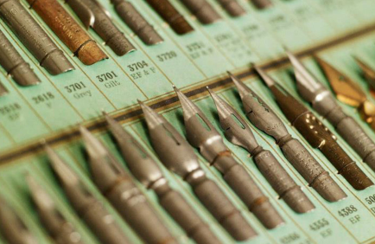
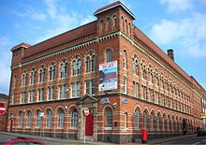
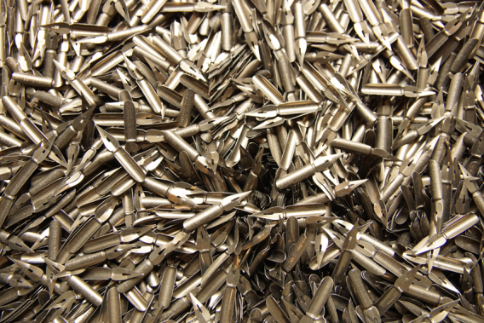
The Pen Museum
This is what this world has turned into… The Pen Museum in Birmingham was created in 2001. It is dedicated to the history of our writing tools. The museum displays many different types of historical pens ranging from duck feather pens to ballpoint.

Slide 3
The Pen Museum

Slide 4
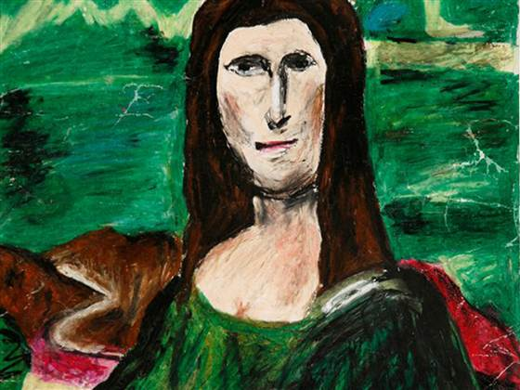
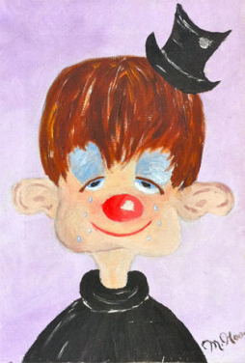
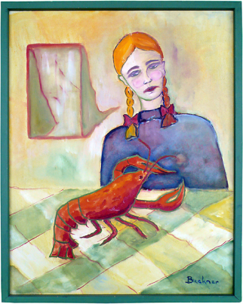
Museum of Bad Art
The Museum of Bad Art, in Michigan, is dedicated to the showcase of terrible drawings. This museum is now permanently closed, but was once opened. There are just bad paintings all over the museum.

Slide 5
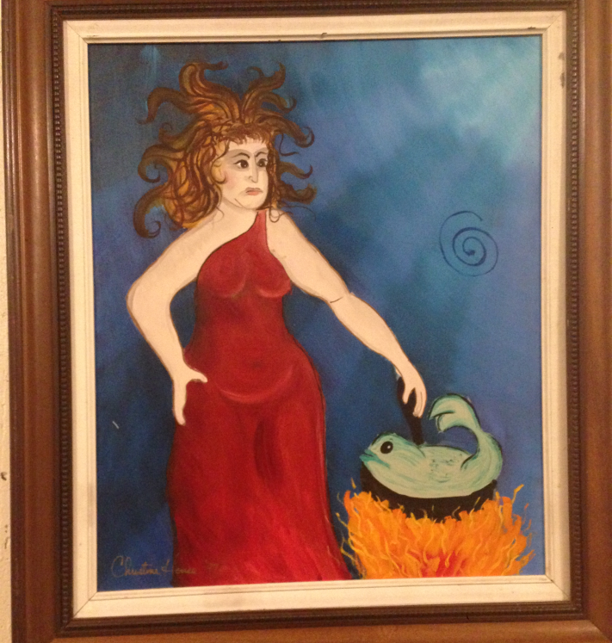
Museum of Bad Art

Slide 6
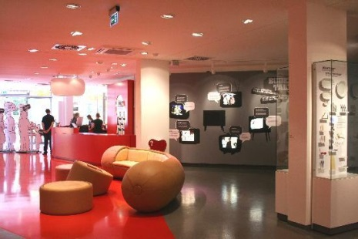
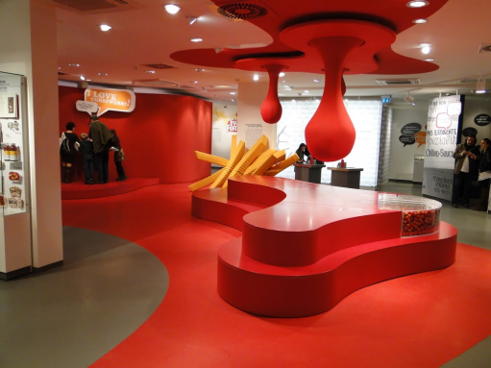
CurryWurst Museum
The Currywurst Museum, is a museum in Berlin just about the Currywurst sausage. This snack is supposedly so great that a museum of it just had to be made. It is “A Celebration for An Iconic Sausage Snack”

Slide 7
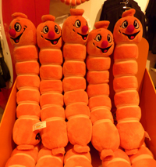
Currywurst Museum

Slide 8
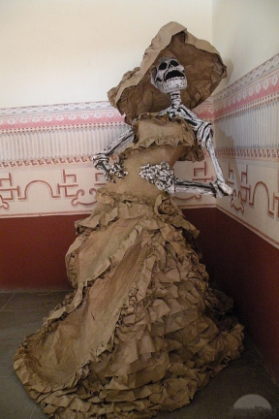
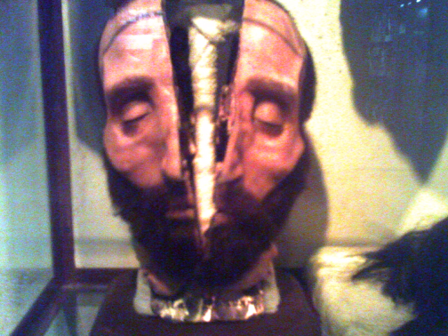
Museum of Death
The museum of Death is a museum in California dedicated to the showing of death. It is probably run by very dark people that wear all black and are goth. It is located in California.

Slide 9
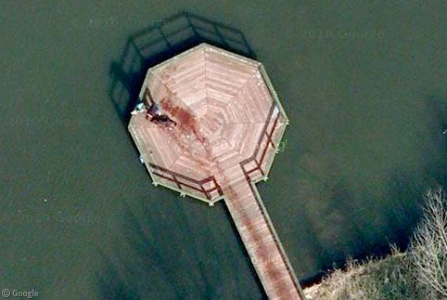
Museum of Death

Slide 10
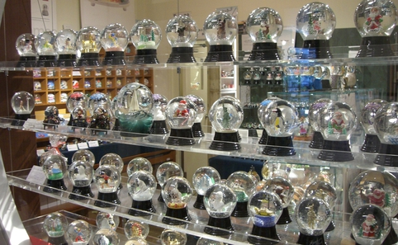
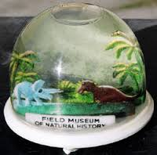
Hompherman Snow Globe Museum
The Hompherman Snow Globe Museum is a museum located in Pawnee, Indiana. This museum is all about snow globes. The museum is not real. It is one of the scenes on a TV show, but I thought that it is very interesting.

Slide 11
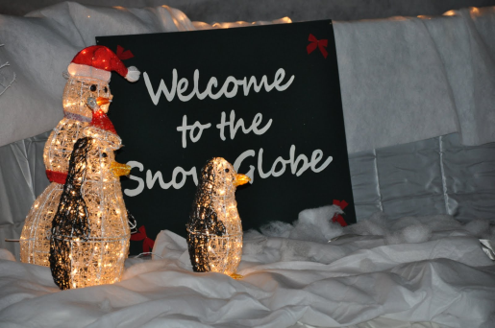
Hompherman Snow Globe Museum

Slide 12
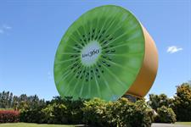
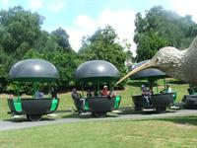
Kiwi 360 Museum
The KIWI 360 Museum is located in New Zealand, and is all things KIWI. The museum has the world’s largest man made museum and also have helicopter rides of fields and a kiwi shaped train ride.

Slide 13
Kiwi 360 Museum

Slide 14
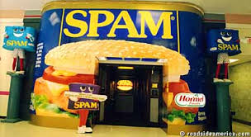
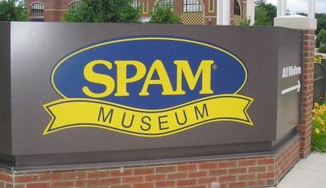
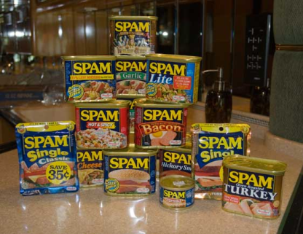
SPAM Museum
The SPAM Museum in Minnesota is dedicated to the canned SPAM meats. The 16,500-square feet facility is jam packed with all that you need to know about the SPAM Meats.

Slide 15
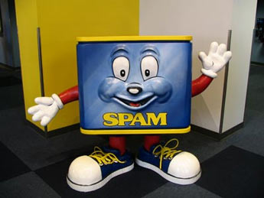
SPAM Museum

